Slide 1
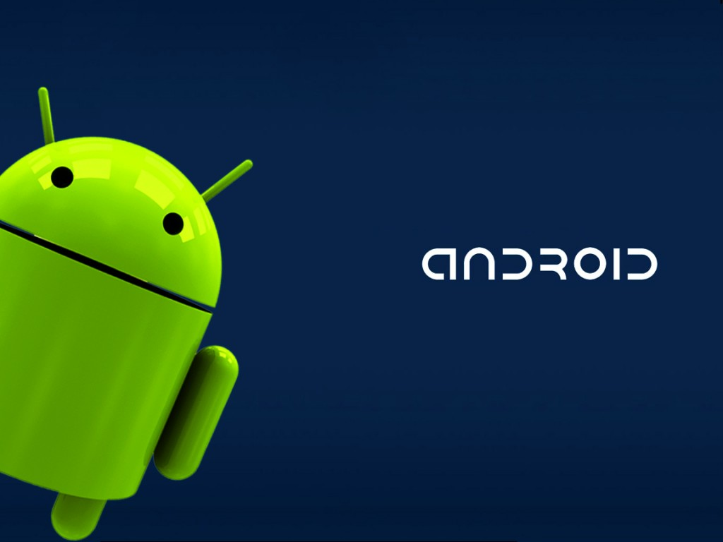

The introduction of Android Development
Alex

Slide 2
Agenda
Brief History
What’s Android
Environment setup
Hello World
Structure of an App
Basic Widget Component (Button, TextView)
Activity
Life Cycle
Activity switch
[APP Demo]
Download image via Internet & Save to SD card & Display
FAQ

Slide 3
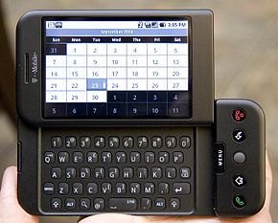
Brief History
Foundation
Android, Inc. was founded in Palo Alto, California, U.S.A. by Andy Rubin, Rich Miner, Nick Sears and Chris White
Acquisition by Google
Google acquired Android Inc. on August 17, 2005
HTC Dream (T-Mobile G1)
The first android mobile phone
Released in October 2008
Android shipments in 2014
exceed 1 billion for first time

Slide 4
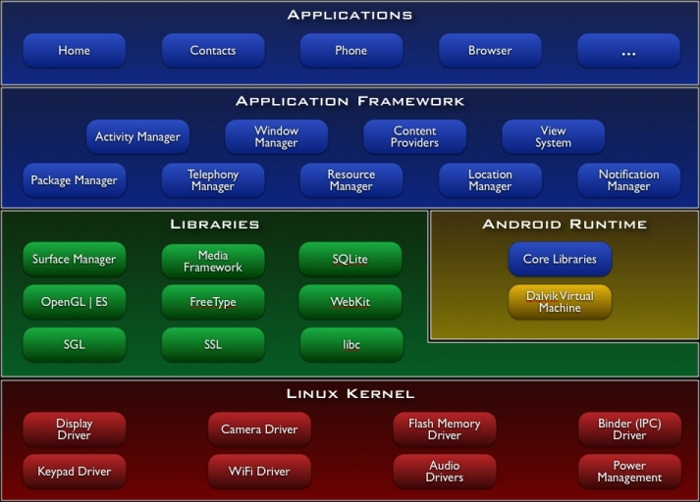
What’s Android?
A software stack for mobile devices that includes
Operating system (Linux based)
Middleware
Key Applications

Slide 5


Environment setup (1/4)
Prerequisite :
IDE: Eclipse or Android Studio
http://developer.android.com/sdk/index.html
JDK: Java Development Kit
http://www.oracle.com/technetwork/java/javase/downloads/jdk8-downloads-2133151.html

Slide 6
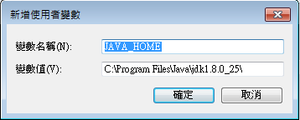
Environment setup (2/4)
Install IDE
Just press “Next” to finish the installation.
Install Java Development Kit
Add environment variable
Variable name: JAVA_HOME
Value: the root folder of JDK

Slide 7
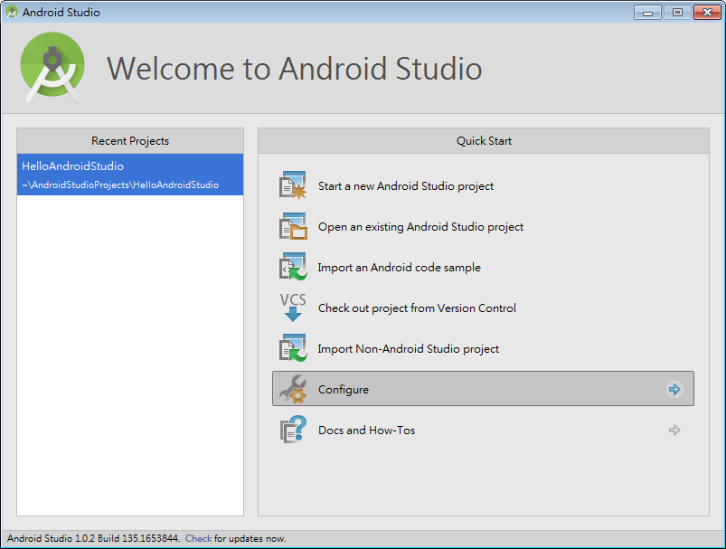
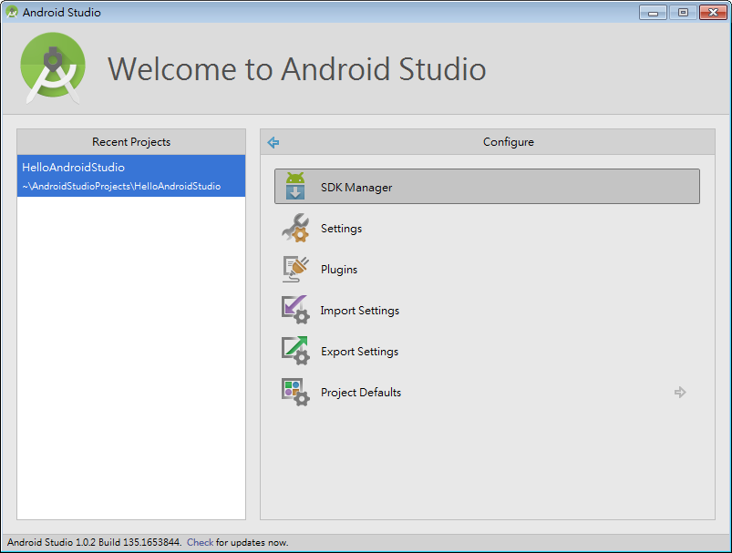
Environment setup (3/4)
Android SDK
Configure -> SDK Manager

Slide 8
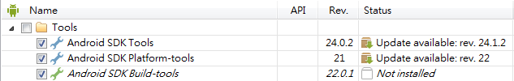
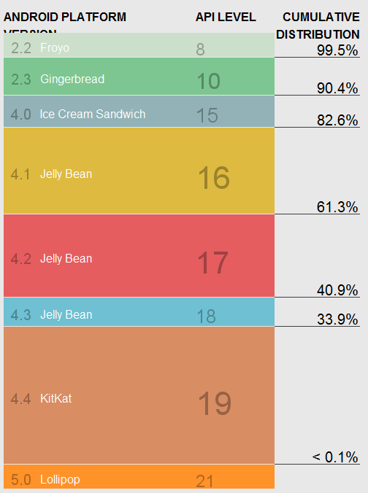
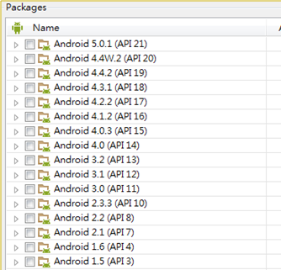
Environment setup (4/4)
Install SDK Tools, Platform-tools and Build-tools
Install Android API
Android 4.0(API 14) cover 90%+
of devices in use now.

Slide 9
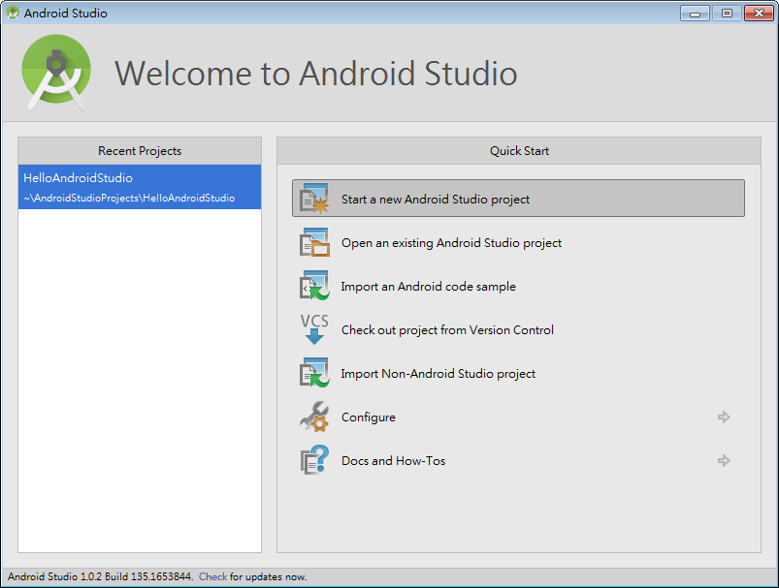
Hello World (1/9)

Slide 10
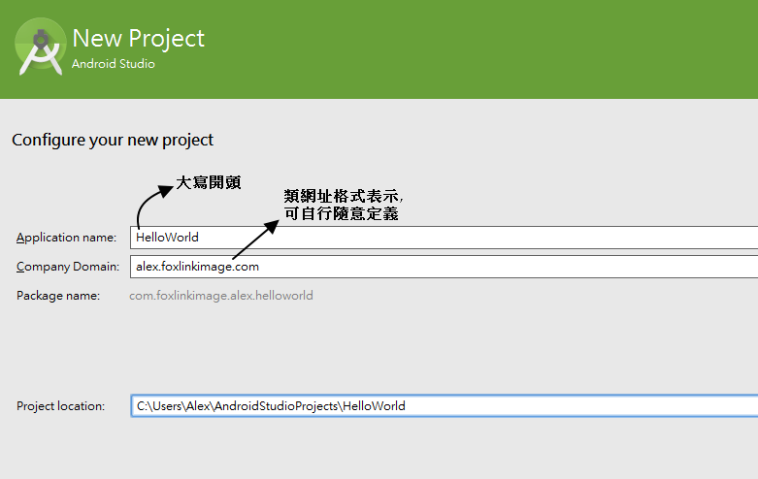
Hello World (2/9)

Slide 11
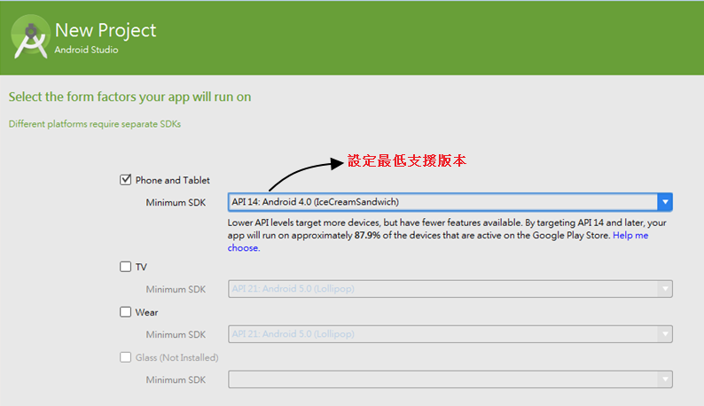
Hello World (3/9)

Slide 12
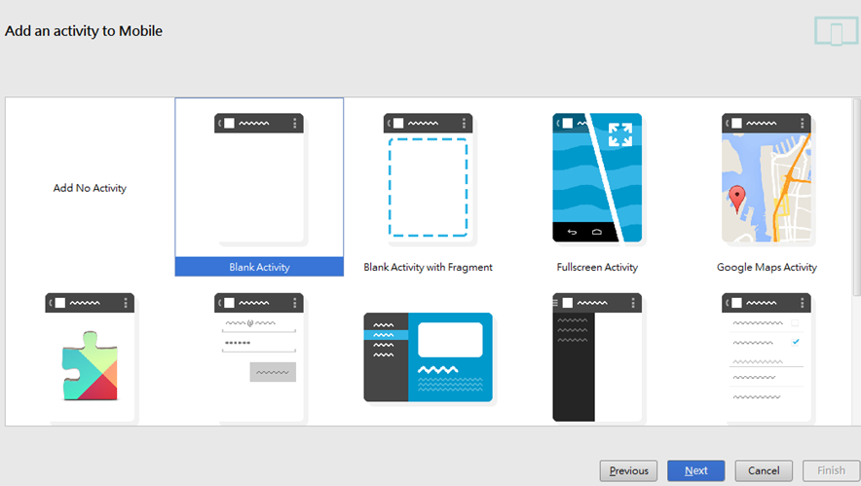
Hello World (4/9)

Slide 13
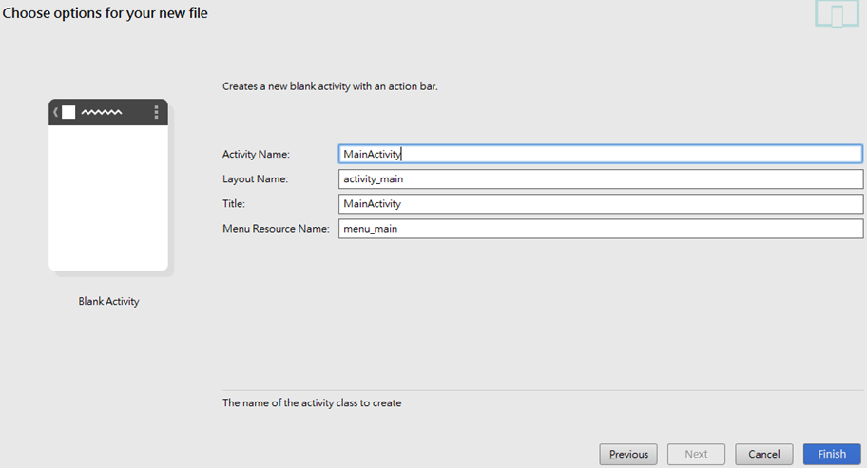
Hello World (5/9)

Slide 14
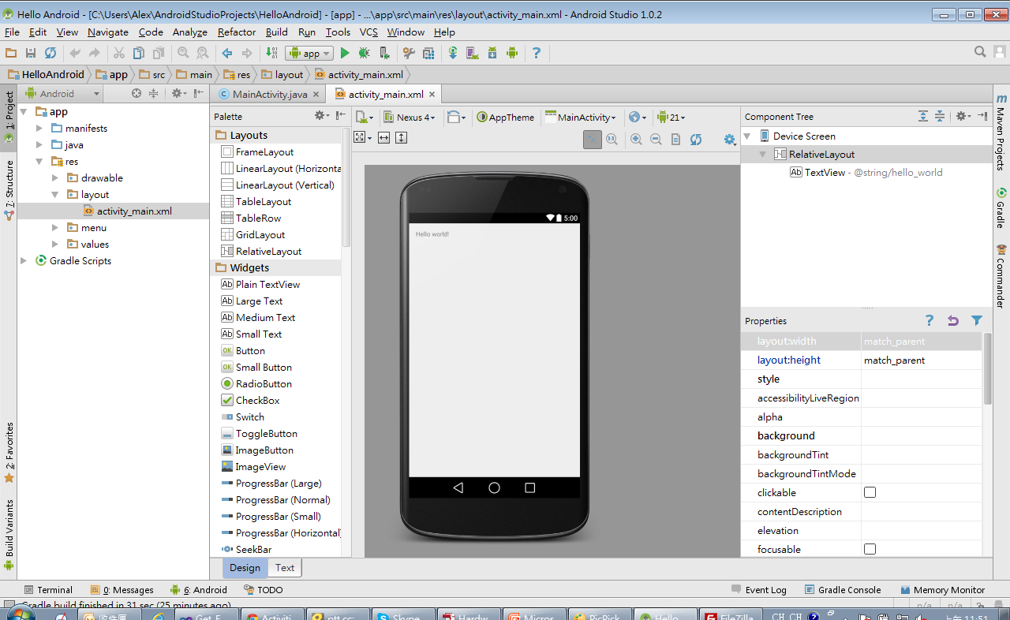
Hello World (6/9)

Slide 15
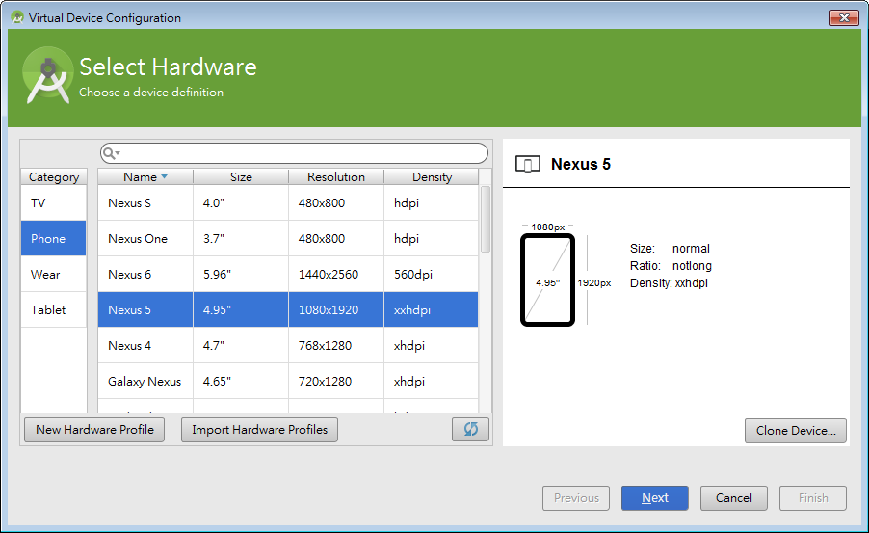
Hello World (7/9)
Run the program
Android Virtual Device
Tool->Android->AVD Manager->Create Virtual Device
Resolution, CPU architecture, RAM, SD Card, Android Ver.

Slide 16
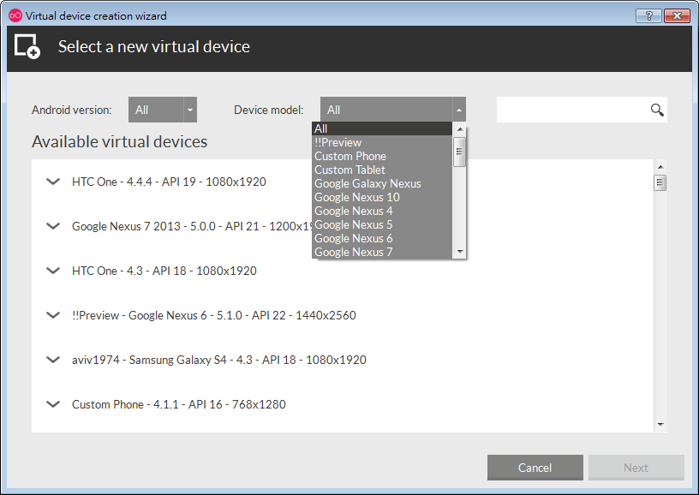
Hello World (8/9)
3rd party emulator: Genymotion (#5)
Faster than the built-in AVD (VirtualBox)
As a plugin of Android Studio

Slide 17
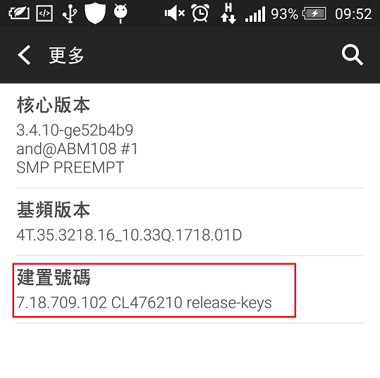
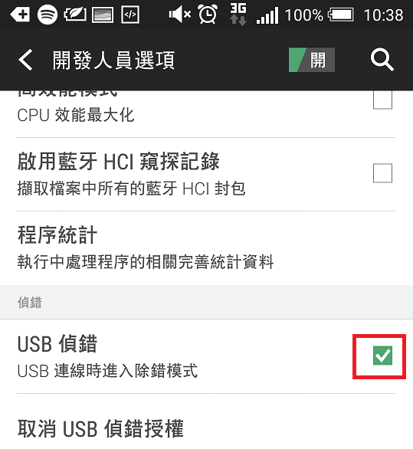
Hello World (9/9)
Mobile Phone
Enable USB debugging. (Default hidden)
Settings -> About Phone -> Build number
Tap 7 times to activate.
Settings -> Developer Options -> USB debugging

Slide 18
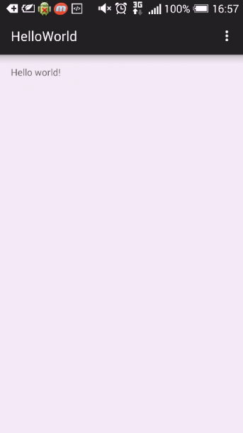
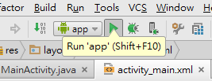
Press run button or Shift +F10 to run program

Slide 19
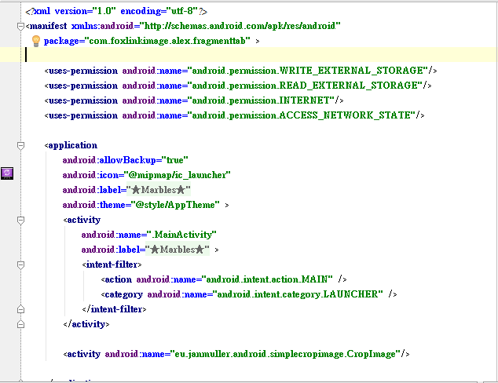
App Structure
manifests – AndroidManifest.xml
Some information about this App
Activity
Permission
Services
…….

Slide 20
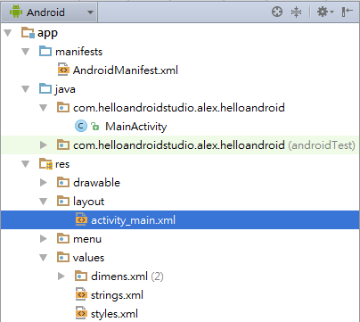
App Structure
java – ****.java
Logic operation

Slide 21
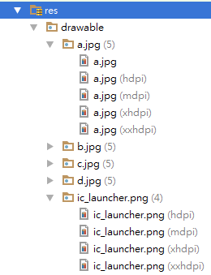
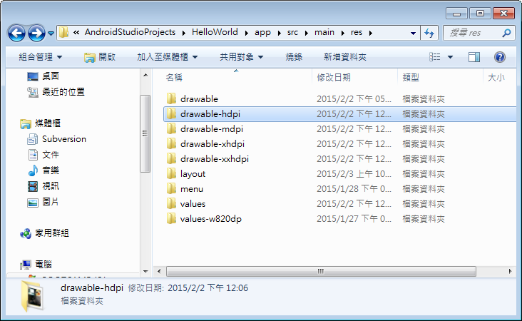
App Structure
res - drawable
Bitmap
App Icon (before Android Studio 1.1)
Shape, Layer, Scale….

Slide 22
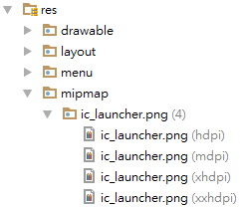
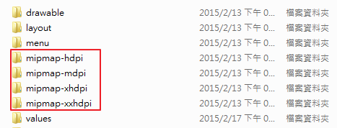
App Structure
res – mipmap (updated! Android Studio 1.1)
App Icon move to mipmap folder

Slide 23
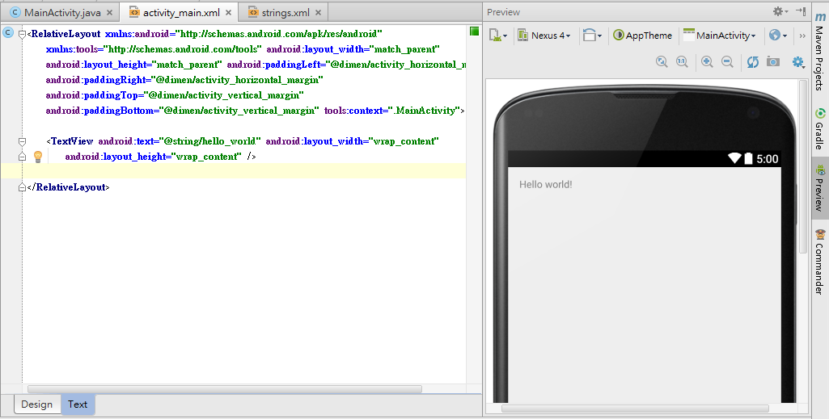
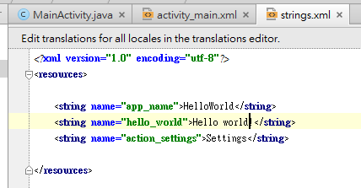
App Structure
res - Layout

Slide 24
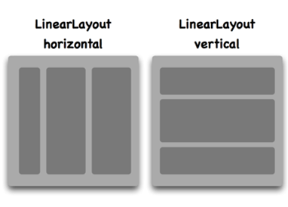
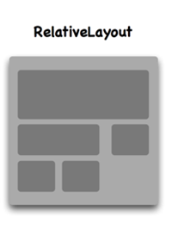
App Structure
LinearLayout
android:orientation = “vertical”
android:orientation = “horizontal”
RelativeLayout
android:layout_above
android:layout_below
android:layout_toStartOf
android:layout_toEndOf
…
Others: FrameLayout, TableLayout, GridLayout

Slide 25
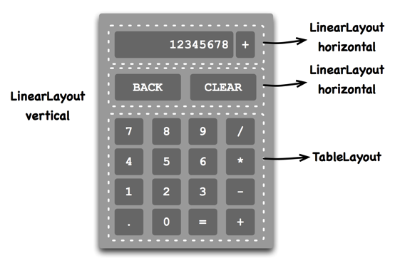
App Structure
Also support nested form

Slide 26
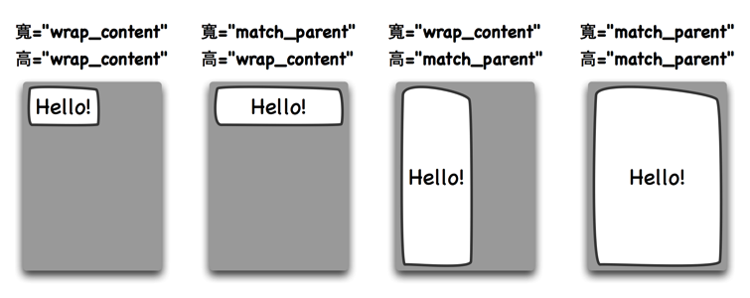
Structure
android:layout_width android:layout_height
Property can be set with:
Absolute value: e.g. 200px or 200dp (Do not hardcode ∵Different screen densities)
wrap_content
match_parent
Note: For android:textSize → uses “sp” instead

Slide 27
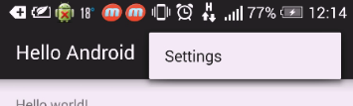
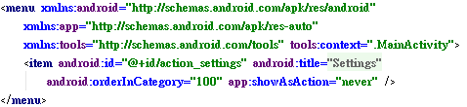
App Structure
res – Menu

Slide 28
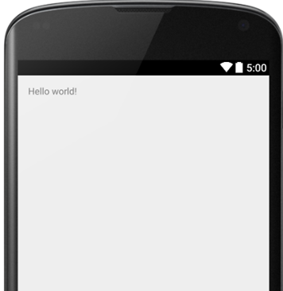
App Structure
res - Values – strings
All of the words should be defined here.
For multi-language purpose.

Slide 29

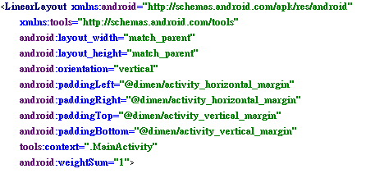
App Structure
res - Values - dimens
dimens.xml
activity_main.xml

Slide 30
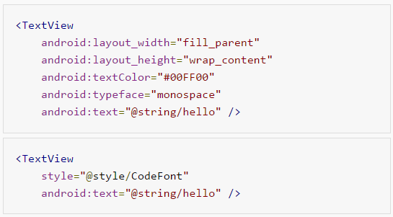
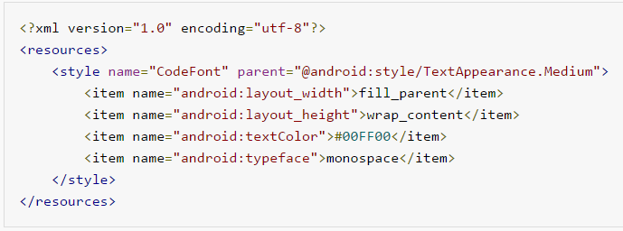
App Structure
res - Values – styles
CSS-like
activity_main.xml
styles.xml

Slide 31
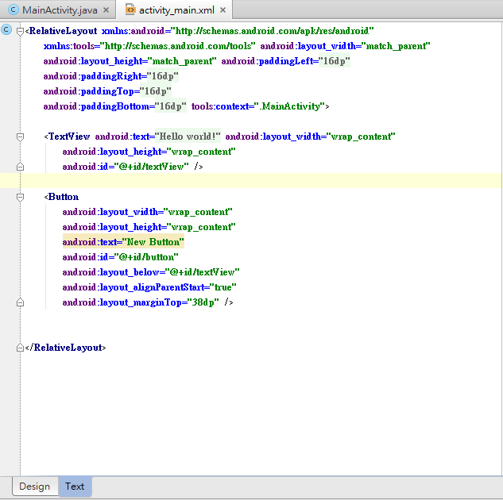
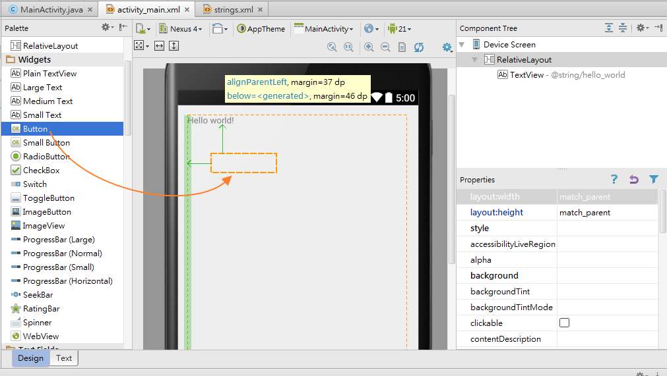
Basic Widget Component
Give it a try! Change “Hello world!” by pressing button.
Add button to the layout.
Press

Slide 32
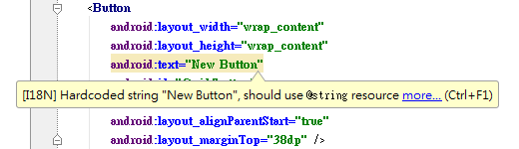

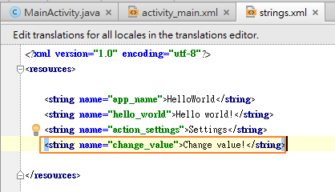
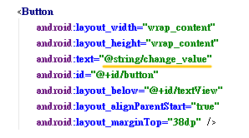

Basic Widget Component
Design
Text
Open strings.xml

Slide 33
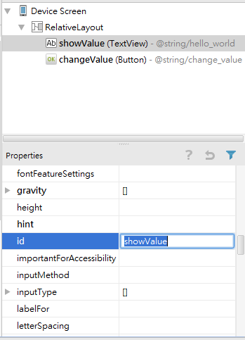
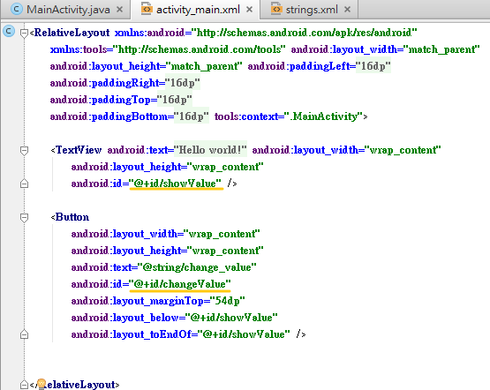
Set ID to each component
Design
Text

Slide 34
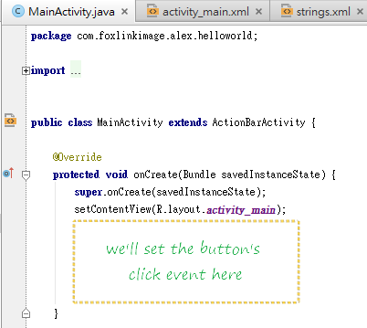
MainActivity.java
onCreate() is the entry point of activity.
setContentView(R.layout.activity_main)
Initial layout

Slide 35
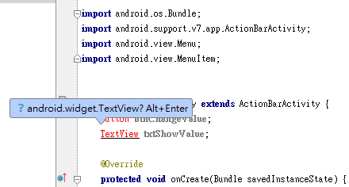
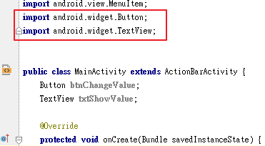
Basic Widget Component
To access component in the program.
Create instance of Button and TextView
Button btnChangeValue;
TextView txtShowValue;
Import android.widget.*

Slide 36
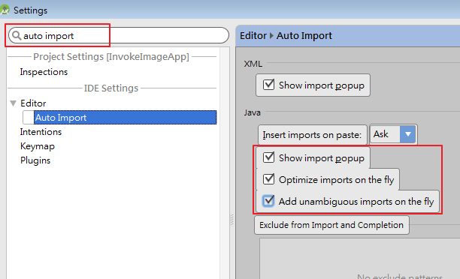
Basic Widget Component
(Hint) Auto import
File -> Settings or Ctrl+Alt+S

Slide 37

Basic Widget Component
Use method “findViewById(ID)”
Return View type, and cast it as
btnChangeValue = (Button)findViewById(R.id.changeValue)
txtShowValue=(TextView)findViewById(R.id.showValue)
Click Listener

Slide 38

Register the Button’s event listener
Notes:
每一個View都可以註冊一個event listener，當Android框架收到「click」事件後，便回呼event listener的callback method。以Button類別（按鈕元件）為例，當我們想要處理使用者觸控按鈕的事件時，就要呼叫Button類別的setOnClickListener()方法來註冊click listener。

Slide 39
Activity
An Activity is an application component that provides a screen with which users can interact in order to do something, such as dial the phone, take a photo, send an email, or view a map. Each activity is given a window in which to draw its user interface.

Slide 40

Activity Life Cycle

Slide 41

Activity Life Cycle

Slide 42



Activity Life Cycle
Press “Back” button

Slide 43


Slide 44

Activity
Give a try! Observe lifecycle of Activity.
Create the second activity.

Slide 45

Activity

Slide 46



Activity
How to switch to another activity
Intent class(意圖)
Explicit intent (顯性)
Intent it = new Intent(MainActivity.this, SecondActivity.class);
StartActivity(it);
Implicit intent (隱性)
http://developer.android.com/training/basics/intents/sending.html

Slide 47
Activity
※Can let Intent carry information to other activity.
MainActivity:
Intent it = new Intent(MainActivity.this, SecondActivity.class);
it.putExtra(“name”, “John”); it.putExtra(“age”, 24);
startActivity(it);
SecondActivity:
String Name = getIntent().getStringExtra(“name”);
int Age = getIntent().getIntExtra(“age”);
使用getIntent()方法,取得資料
Name: John
Ahe:24
MainActivity
SecondActivity

Slide 48
Activity
※Also can get return data from Second Activity
MainActivity:
StartActivityForResult(Intent intent, int requestCode)
@Override onActivityResult(int requestCode, int resultCode, Intent data)
SecondActivity:
setResult (int resultCode, Intent data)
RequestCode
Name: John
Ahe:24
MainActivity
SecondActivity
ResultCode
data

Slide 49

Activity
Override baseclass method
by pressing ctrl + O:
onStop()
onStart()
onRestart()
onPause()
onResume()
onDestroy()

Slide 50


We use util.Log class to print the runtime message (like printf)
Declare a variable LOG_TAG = “##Tag##”
In each override method, add:
Log.d(LOG_TAG, ”Message”)
Press Debug
Use debug tool (DDMS) to get the message

Slide 51

Activity

Slide 52
Activity
Activity life cycle demo

Slide 53

APP Demo
Widget Component:
Button
TextView
ImageView
Spinner
ProgressBar
Features:
Download img
Show DL progress
Load img
Invoke other app

Slide 54

APP Demo
Main Thread (UI Thread)
Created when app starts.
ANR(Android is not responding) issue
Perform a time-consuming task.
(e.g. Downloading, Database read/write)

Slide 55

APP Demo
Background thread (Worker Thread)
Can’t access UI component directly.
Handler

Slide 56
APP Demo
AsyncTask class
AsyncTask enables proper and easy use of the UI thread. This class allows to perform background operations and publish results on the UI thread without having to manipulate threads and/or handlers.

Slide 57
APP Demo
To use this class, you may create your own class and extends it.
private class MyTask extends AsyncTask<Void, Void, Void> { ... }
Run on | Override Method | Remark
UI Thread | onPreExecute() | Executed before the task.
Background Thread | doInBackground(Params...) - publishProgress(Progress…) | Abstract method, should be implemented.
UI Thread | onProgressUpdate(Progress...) | Can update task’s progress on UI.
UI Thread | onPostExecute(Result) | Executed when task finished.

Slide 58
APP Demo
Sample code
How to use
private class DownloadFilesTask extends AsyncTask<URL, Integer, Long> { protected Long doInBackground(URL... urls) { int count = urls.length; long totalSize = 0; for (int i = 0; i < count; i++) { totalSize += Downloader.downloadFile(urls[i]); publishProgress((int) ((i / (float) count) * 100)); } return totalSize; } protected void onProgressUpdate(Integer... progress) { setProgressPercent(progress[0]); } protected void onPostExecute(Long result) { showDialog("Downloaded " + result + " bytes"); } }
new DownloadFilesTask().execute(url1, url2, url3);

Slide 59

APP Demo
Permission setting
AndroidManifest.xml

Slide 60
The other important components
Service
No UI
Always works in the background.
Abstract class
Scenario: Play music, data download….
Broadcast receiver
An app send the broadcast to the whole system.
Others app which register for the broadcast will receive the information.
Scenario: Battery level low, Receive email…
Content Provider
Cross-process data exchange

Slide 61
Reference
Android Developer - http://developer.android.com/develop/index.html
CodeData –
http://www.codedata.com.tw/mobile/android-tutorial-the-2nd-class-2-ui/
Activity –
http://blog.csdn.net/xln0130/article/details/6721561
4. AsyncTask -http://developer.android.com/reference/android/os/AsyncTask.html
5. Genymotion (3rd-party Android Emulator) -
https://www.genymotion.com/
Android History –
http://www.xcubelabs.com/images/android-infograph-live.png

Slide 62
Thank You

